Slide 1
Report On Improving the Robustness of Image Style Transfer

Slide 2
What is this Paper about ?
From the previous research , we can say features extracted from VGG network has a great ability to capture the style of a image .
But the style quality often decreases when applied to features from lightweight networks such as ResNet family.
Robustness can be improved a lot by just introducing softmax to feature activations of ResNet. small trick can change stylization quality of a model with random weights too.
So architecture used for feature extraction is more important rather than the usage of learned weights.
This paper doesn’t introduce any new algorithm , It just make the previously discovered algorithms to various set of architectures .
This paper discusses the architecture robustness of style transfer.

Slide 3
Introduction
Robustness is not a property of training data , But it is inherent to architecture.
When converting to a probability distribution ResNet had showed larger peaks with small entropy . They are dominated by few channels . So optimization of stylized images is biased into replicating some dominant patterns of style image & ignoring the rest.
This is due to skip layers or shortcut layers in ResNet , whereas in VGG all the activations are unform for all layers . Residual connections are not good for style transfer.
Smoothing the activation functions had improved the performance of stylized images . This version of stylization is called as Stylization With Activation smoothinG (SWAG).

Slide 4

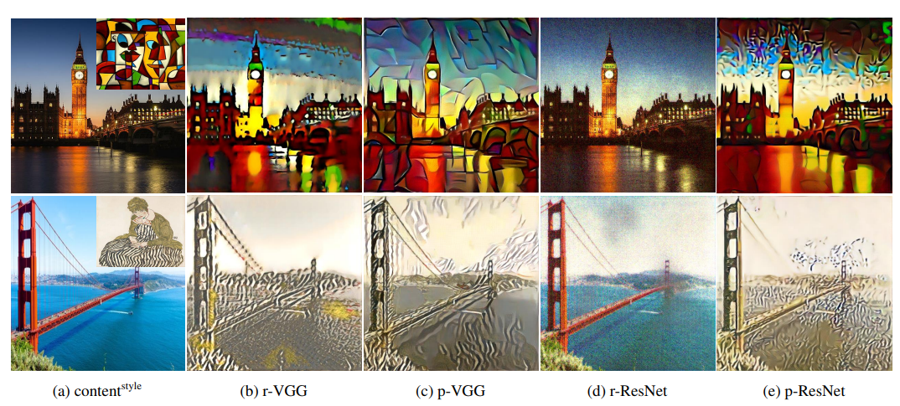
Importance of Residual Connections
Here we can see p-ResNet produces more noisier images when compared to p-VGG .
The results are worst for r-ResNet when compared to r-VGG.
r-ResNet simply failed to stylize the image.

Slide 5
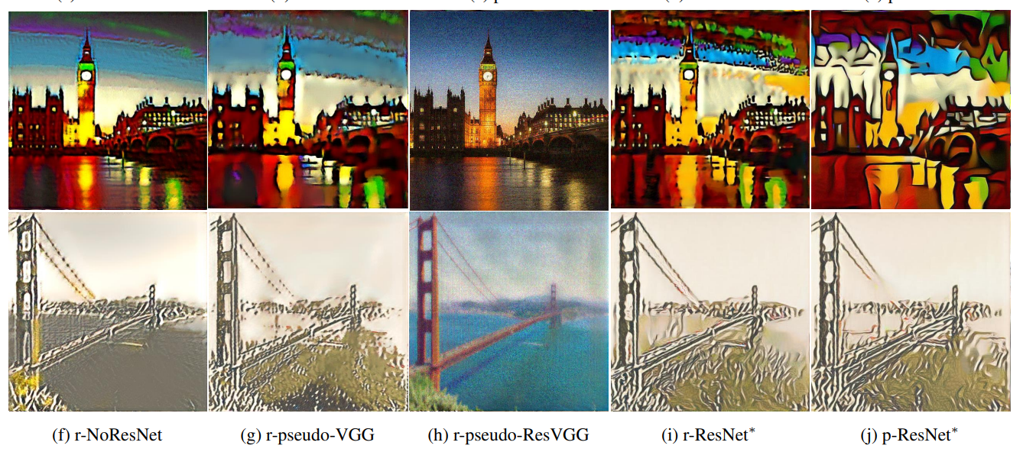
Importance of Residual Connections
Here for confirmation of the reason of degradation of ResNet architecture is due to residual layers , We compared the performances with NoResNet architecture.
We can see drastically increase in performance for NoResNet.
By changing some modifications of NoResNet and making it similar to VGG had made Pseudo VGG model. It’s performance is almost similar to VGG.
We then added residual connections to pseudo VGG , which is denoted as r-pseudo-ResVGG , we can see that all the gains for pseudo VGG have gone.
Their performamce is similar to r-ResNet.From this we can confirm that weak performance of ResNet is due to it’s residual networks.

Slide 6
Why residual connections degrade the performance ?

Slide 7
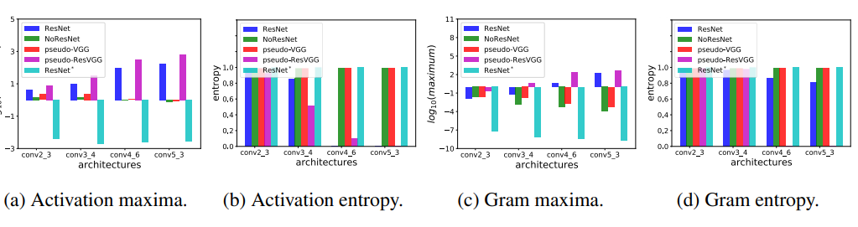
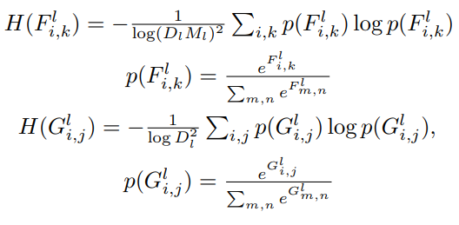
Here we present the maximum values of maxi,k F l i,k and maxi,j Gl i,j & entropies in the graph. The entropies are calculated with the formula
We can see that for networks without residual connections ( NoResNet , pseudo VGG ) max value decreases & entropy almost remains the same with the layer.
Where as for residual connected network ( ResNet , pseudo – ResVGG ) max value increases & entropy decreases with the layer.

Slide 8
Reasons for decrease in robustness of non-VGG models is due to their decrease in entropy over the layers.
Over the layers , activation function entries are peaky leading to peaky gram matrix entries . i.e. while going through the layers we are having one entry of the gram matrix as large as possible and all the remaining entries will be as small as possible . This leads to decrease in graph of entropy & Gradually entropy reaches zero gradually.
So entries of gram matrix will be purely dominated by some type of features & which clearly leads to non uniform distribution of stylation over image. Which there by decreases the stylation quality.

Slide 9
Why Residual network activations & Gram matrices peaky ?

Slide 10
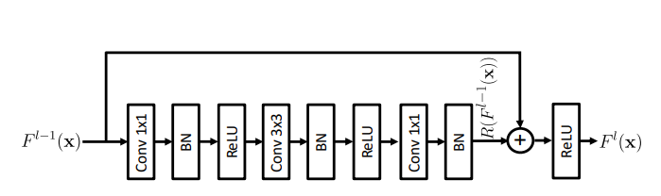
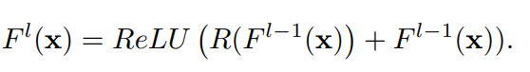
Reasons
We take a bottleneck ResNet Block .
So we get output as
A large value of F l i (x) can be due to a) large residual Ri(F l−1 (x)) b) a positive residual Ri(F l−1 (x)) if F l−1 i (x) is already large.
We can say once large activation appears in an intermediate layers , all the subsequent layers could be forced to “whack a mole “ sequence leading to larger values to other layers.
Hence as depth l increases activation functions & gram matrices become peakier , leading to low entropy.

Slide 11
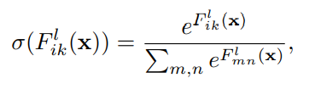
Stylization with activation smoothing
We smoothen the activation functions for getting fair results. Let’s just consider smoothing with softmax and the resultant activation functions wil be
The softmax layer won’t be included anywhere. But we are just using these updated values in the loss functions.
Introducing softmax reduced the max value and increase the entropy creating a uniform distribution.
Results of r-ResNet* are almost similar to that of r-VGG.
Results of p-ResNet* outperformed p-VGG.

Slide 12
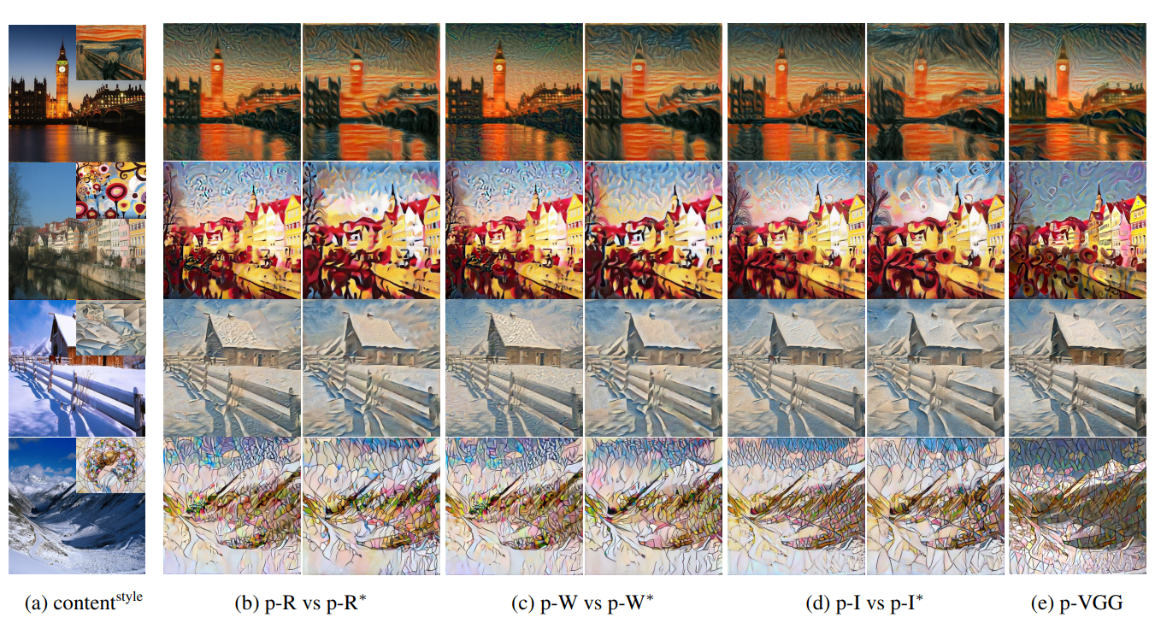
Qualitative Evaluation
We can see improved results of using swag for different types of architecture.
Here
R – ResNet
V – VGG
W – Wide ResNet
I – Inception-v3

Slide 13
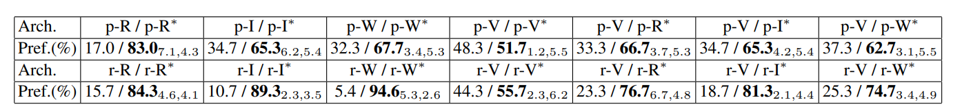
Quantitative Evaluation
Quantitative evaluation for style is difficult because it is subjective.
This paper uses user study for quantitative evaluation .They presented the results of user study on Amazon Mechanical Turk.The results are given below.
We can say that everyone chose SWAG version over the normal.
Every SWAG version model had out performed the Standard VGG Model.
So We can say SWAG eliminated the dependency on VGG.

Slide 14
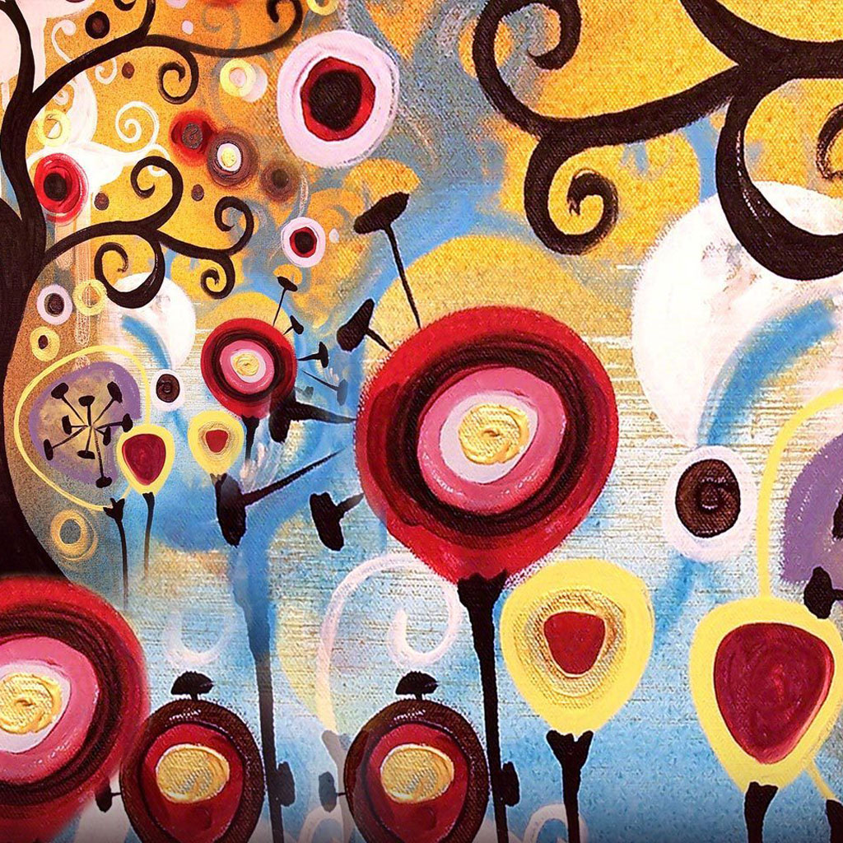
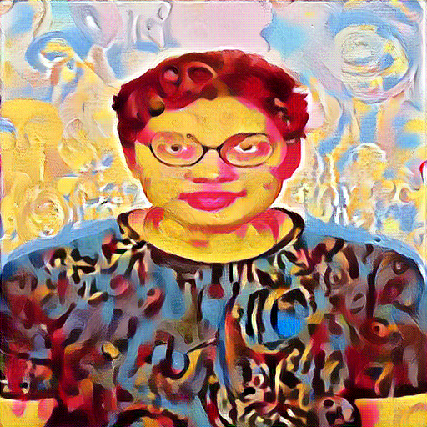
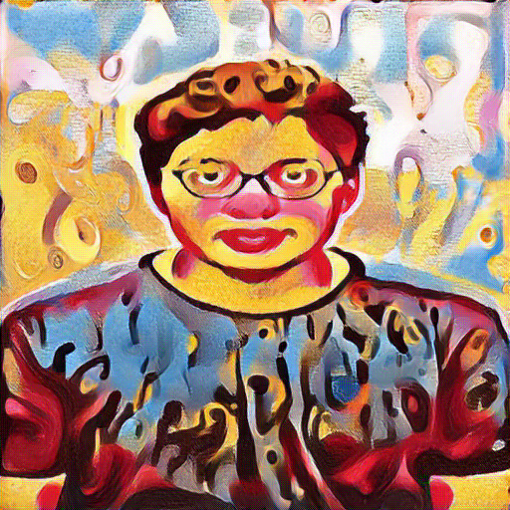
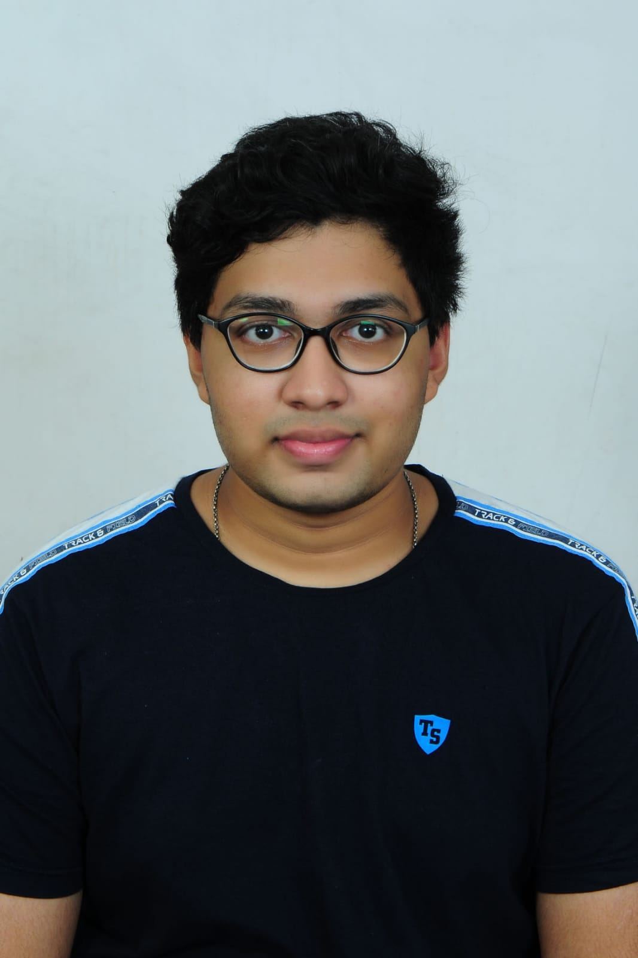
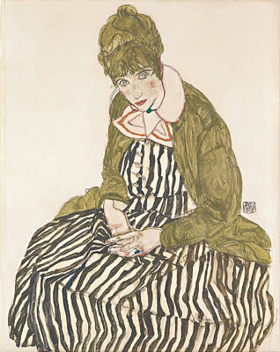
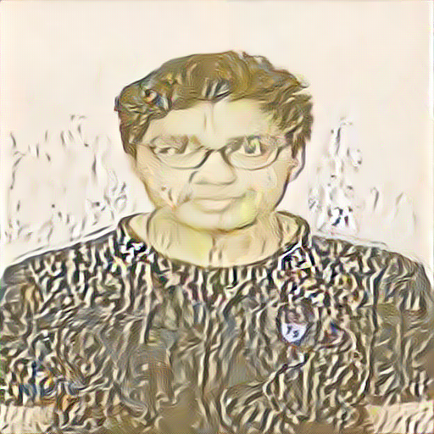
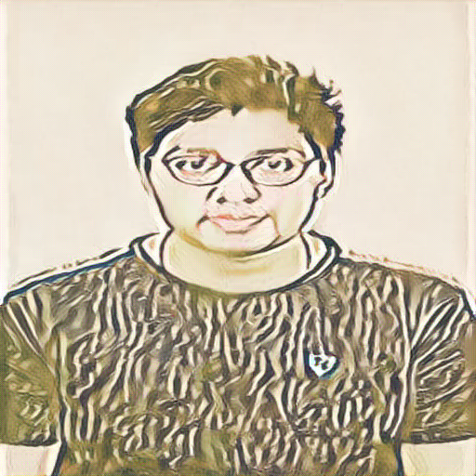
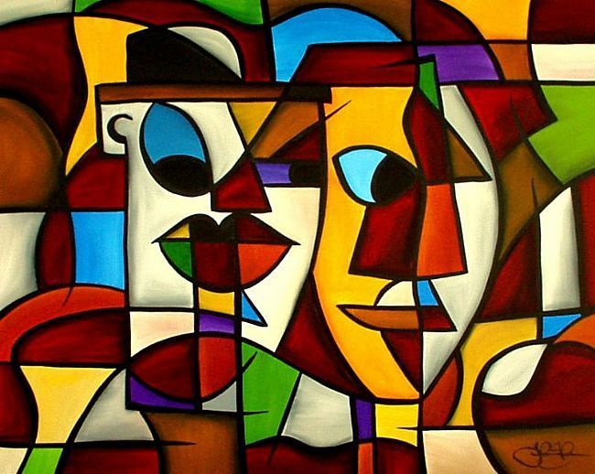
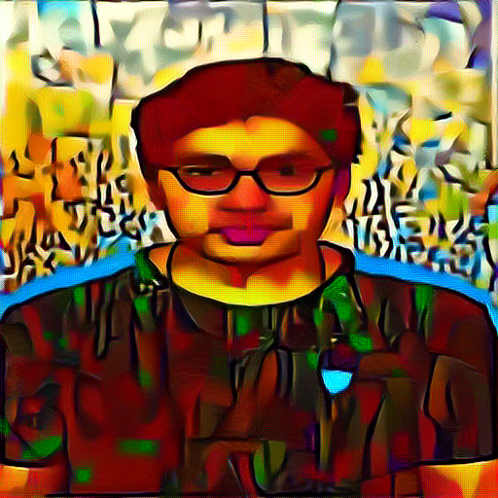
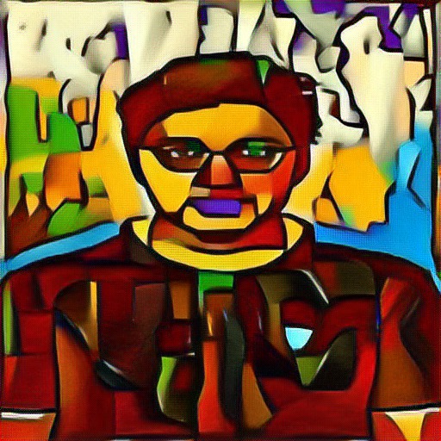
ResNet ResNet *

Slide 15
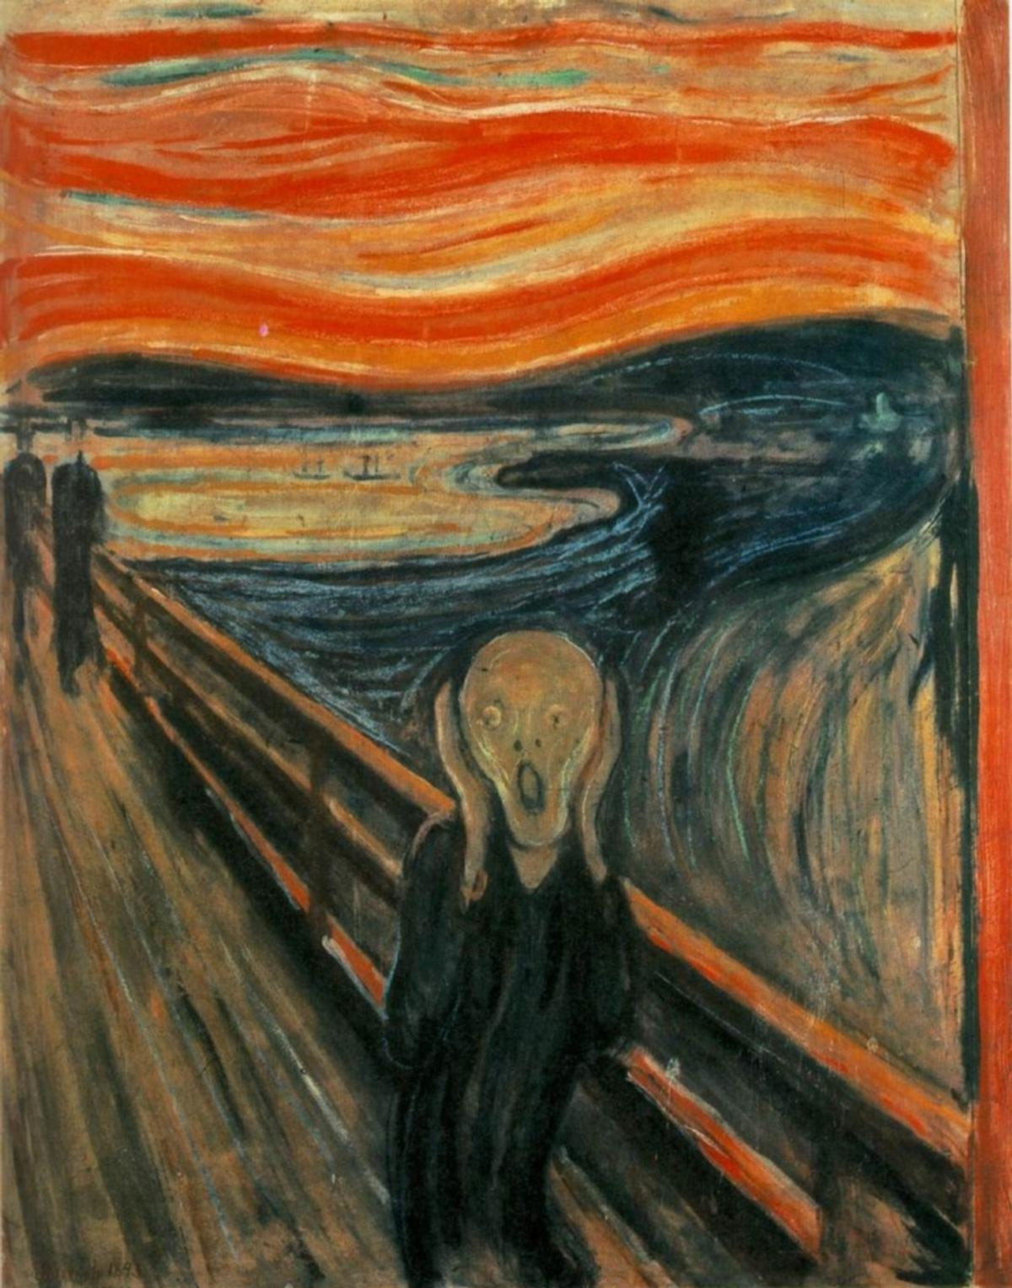
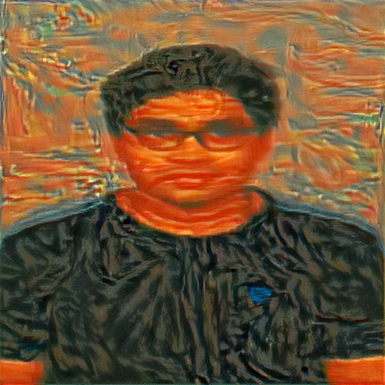
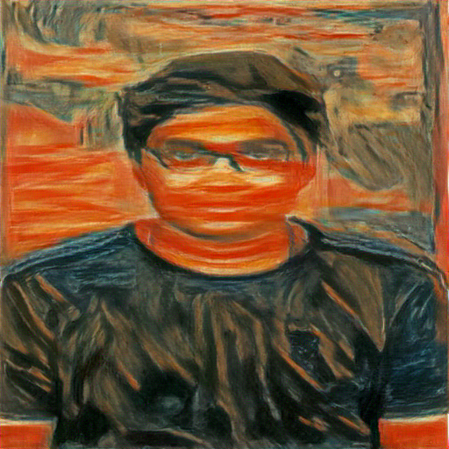
Results

Slide 16
Conclusion
We saw the lack of robustness of images generated via non-VGG architectures.
We found the reason behind it is due to residual connections .
We then proposed solution of smoothing the activation functions known as SWAG.
We got to know that SWAG version of various light weight architectures had outperformed the standard VGG architecture.
Inference time is around 30 to 40 mins .

